Slide 1
Recitation 8

Slide 2
Info
Jon Rutkauskas
Recitation: Tue 12-12:50
Office Hours: Tue 11-11:50 Thur 11-12:50 SENSQ 5806 (additional hours by appointment if needed)
On discord: @jrutkauskas
By email: jsr68@pitt.edu
Website: https://github.com/jrutkauskas/spring2019-449-rec
Ask me any questions you have!!!

Slide 3
Exam 1
So, all of you have taken it now :-)
I haven’t seen it or the key, but I officially can answer any questions you may have.

Slide 4
Warmup Poll

Slide 5
Project 3
Project 3 is out, and it’s lots of fun.
Start with mystrings. It’s relatively straightforward, and kind-of easy points for this project.
Then, you have your executables to crack
Use your mystrings, your gdb skills, your x86 skills, your Google skills, etc. to help
https://jarrettbillingsley.github.io/teaching/classes/cs0449/projects/proj3_details.html ← MAJOR HELP RIGHT HERE!

Slide 6
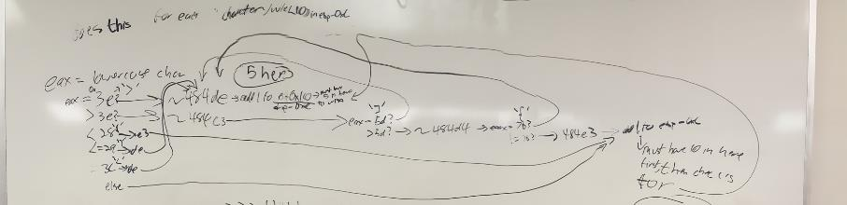
Instead, learn the patterns by writing your own little test programs with if-elses, loops, and switches. Compile them with the -m32 and -g flags and inspect their disassembly. Once you see what the compiler will produce for each kind of control structure, you’ll start to notice the patterns and be able to think “oh, this is an if-else.”
This tidbit of info from the project description? You probably shouldn’t ignore it.
x86 looks so messy and complicated, it’s good to be able to see something familiar.
Also possibly recommended: Go get a whiteboard or large piece of paper and just draw out the control structure
My old whiteboard scribbles from this project

Slide 7
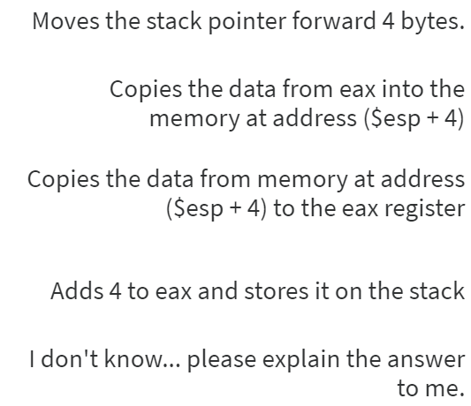
What does mov [esp+4], eax do?

Slide 8
What does mov [esp+4], eax do?
We aren’t changing the value of stack pointer
We are going into memory at the address of (esp+4) and storing the contents of eax there.
Like saying *(esp + 4 bytes) = eax
Remember the destination comes first, then the source
We aren’t changing the data in eax

Slide 9
What is this function doing?
(gdb) disas fun
Dump of assembler code for function fun:
0x08048394 <+0>: push ebp
0x08048395 <+1>: mov ebp,esp
0x08048397 <+3>: cmp DWORD PTR [ebp+0x8],0xa
0x0804839b <+7>: jle 0x80483a4 <fun+16>
0x0804839d <+9>: mov eax,0x32
0x080483a2 <+14>: jmp 0x80483a9 <fun+21>
0x080483a4 <+16>: mov eax,0x0
0x080483a9 <+21>: pop ebp
0x080483aa <+22>: ret
End of assembler dump.

Slide 10
IT’s just this…
int fun(int x)
{
if(x > 10)
return 50;
else
return 0;
}

Slide 11
(gdb) disas /m fun
Dump of assembler code for function fun:
4 {
0x08048394 <+0>: push ebp
0x08048395 <+1>: mov ebp,esp
5 if(x>10)
0x08048397 <+3>: cmp DWORD PTR [ebp+0x8],0xa
0x0804839b <+7>: jle 0x80483a4 <fun+16>
6 return 50;
0x0804839d <+9>: mov eax,0x32
0x080483a2 <+14>: jmp 0x80483a9 <fun+21>
7 else
8 return 0;
0x080483a4 <+16>: mov eax,0x0
9 }
0x080483a9 <+21>: pop ebp
0x080483aa <+22>: ret
End of assembler dump.

Slide 12
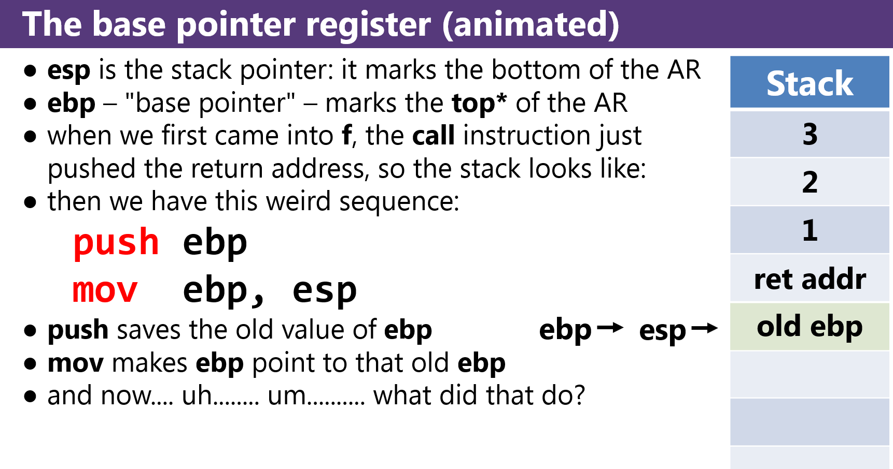
(gdb) disas /m fun
Dump of assembler code for function fun:
4 {
0x08048394 <+0>: push ebp
0x08048395 <+1>: mov ebp,esp
5 if(x>10)
0x08048397 <+3>: cmp DWORD PTR [ebp+0x8],0xa
0x0804839b <+7>: jle 0x80483a4 <fun+16>
6 return 50;
0x0804839d <+9>: mov eax,0x32
0x080483a2 <+14>: jmp 0x80483a9 <fun+21>
7 else
8 return 0;
0x080483a4 <+16>: mov eax,0x0
9 }
0x080483a9 <+21>: pop ebp
0x080483aa <+22>: ret
As we add local variables in our function, we will move esp down more. ebp will stay in place there
ebp + 0x8 is actually referencing the first argument passed to our function!
Recall:
ebp + 0x8
ebp + 0x4
Source: Lecture 12 – Programs – Calling Conventions

Slide 13
(gdb) disas /m fun
Dump of assembler code for function fun:
4 {
0x08048394 <+0>: push ebp
0x08048395 <+1>: mov ebp,esp
5 if(x>10)
0x08048397 <+3>: cmp DWORD PTR [ebp+0x8],0xa
0x0804839b <+7>: jle 0x80483a4 <fun+16>
6 return 50;
0x0804839d <+9>: mov eax,0x32
0x080483a2 <+14>: jmp 0x80483a9 <fun+21>
7 else
8 return 0;
0x080483a4 <+16>: mov eax,0x0
9 }
0x080483a9 <+21>: pop ebp
0x080483aa <+22>: ret
End of assembler dump.

Slide 14
Assembly is ‘fun’?

Slide 15
Lab 5
Lab 5 is out and it’s on everyone’s favorite topic: POINTERS!
Two functions to implement:
int filter(void* output, const void* input, int length, int item_size, PREDICATE pred)
{
// FILL ME IN!
}
int less_than_50(const void* p)
{
// FILL ME IN!
}

Slide 16
Lab 5
int filter(void* output, const void* input, int length, int item_size, PREDICATE pred)
{
// FILL ME IN!
}
int less_than_50(const void* p)
{
// FILL ME IN!
}
Start with less_than_50. It’s your ‘predicate’ function.
Predicate functions are just “something that gives a yes-or-no answer.”
You return zero or nonzero based on whether the value of p is less than 50 or not.
If it’s less than 50, return anything that isn’t zero, otherwise, return 0
You’ll need to change that data type! Void pointers are useless here.
This function will be used in filter to determine whether or not a value should be included in the output array.

Slide 17
Lab 5
int filter(void* output, const void* input, int length, int item_size, PREDICATE pred)
{
// FILL ME IN!
}
// call in main
...
int filtered_len = filter(filtered, float_values, NUM_VALUES, sizeof(float), &less_than_50);
...
Filter is a bit more complicated.
You have your input array and its length. You’ll iterate over it. Remember that each element in the array is item_size in length (be careful moving that pointer forward the correct amount, no PTR_ADD_BYTES here!).
On each of those elements, call the predicate function on them (pred)
If it returns a nonzero value, then use memcpy to copy the data from input to output (again, be careful with size)
Remember to be careful about maintaining your place in the output array as well.
Oh yeah, and also keep a quick count of how many items you copied to output and return that

Slide 18
High-Level Overview of Filter
25
73
4
-8
55
71
input
output

Slide 19
High-Level Overview of Filter
25
73
4
-8
55
71
input
Remember, we’re using pointers here, not indexing into the array.
output

Slide 20
High-Level Overview of Filter
25
73
4
-8
55
71
input
output

Slide 21
High-Level Overview of Filter
25
73
4
-8
55
71
input
Predicate function returns nonzero?
output

Slide 22
High-Level Overview of Filter
25
73
4
-8
55
71
input
Predicate function returns nonzero?
25
output

Slide 23
High-Level Overview of Filter
25
73
4
-8
55
71
input
25
output

Slide 24
High-Level Overview of Filter
25
73
4
-8
55
71
input
Predicate function returns nonzero?
25
output

Slide 25
High-Level Overview of Filter
25
73
4
-8
55
71
input
25
output

Slide 26
High-Level Overview of Filter
25
73
4
-8
55
71
input
Predicate function returns nonzero?
25
output

Slide 27
High-Level Overview of Filter
25
73
4
-8
55
71
input
Predicate function returns nonzero?
25
4
output

Slide 28
High-Level Overview of Filter
25
73
4
-8
55
71
input
25
4
output

Slide 29
High-Level Overview of Filter
25
73
4
-8
55
71
input
Predicate function returns nonzero?
25
4
output

Slide 30
High-Level Overview of Filter
25
73
4
-8
55
71
input
Predicate function returns nonzero?
25
4
-8
output

Slide 31
High-Level Overview of Filter
25
73
4
-8
55
71
input
25
4
-8
output

Slide 32
High-Level Overview of Filter
25
73
4
-8
55
71
input
Predicate function returns nonzero?
25
4
-8
output

Slide 33
High-Level Overview of Filter
25
73
4
-8
55
71
input
25
4
-8
output

Slide 34
High-Level Overview of Filter
25
73
4
-8
55
71
input
Predicate function returns nonzero?
25
4
-8
output

Slide 35
High-Level Overview of Filter
25
73
4
-8
55
71
input
25
4
-8
output

Slide 36
High-Level Overview of Filter
25
73
4
-8
55
71
input
25
4
-8
output
Return 3, the number of items we copied into output

Slide 37
Lab 5
https://jarrettbillingsley.github.io/teaching/classes/cs0449/labs/lab5.html
Take a look at the implementation of qsort demo code
Follow the instructions.
Due Saturday

